Slide 1
Computer Systems Architecture

Slide 2
Pipelining

Slide 3
Introduction
In a typical system speedup is achieved through parallelism at all levels: Multi-user, multi-tasking, multi-processing, multi-programming, multi-threading, compiler optimizations.
Pipelining : is a technique for overlapping operations during execution. Today this is a key feature that makes fast CPUs.
Different types of pipeline: instruction pipeline, multi-issue pipelines.

Slide 4
What is Pipelining?
A pipeline has many steps or stages or segments.
Each stage carries out a different part of instruction or operation.
The stages are connected to form a pipe.
An inst or operation enters through one end and progresses thru’ the stages and exit thru’ the other end.
Pipelining is an implementation technique that exploits parallelism among the instructions in a sequential instruction stream.

Slide 5
Pipelining: Its Natural!
Laundry Example
Ann, Brian, Cathy, Dave each have one load of clothes to wash, dry, and fold
Washer takes 30 minutes
Dryer takes 40 minutes
“Folder” takes 20 minutes
A
B
C
D

Slide 6
Sequential Laundry
6 PM
7
8
9
10
11
Midnight
Time
30
40
20
30
40
20
30
40
20
30
40
20
T
a
s
k
O
r
d
e
r
A
Sequential laundry takes 6 hours for 4 loads
If they learned pipelining, how long would laundry take?
B
C
D

Slide 7
Pipelined Laundry Start work ASAP
6 PM
7
8
9
10
11
Midnight
Time
30
40
40
40
40
20
T
a
s
k
O
r
d
e
r
A
Pipelined laundry takes 3.5 hours for 4 loads
B
C
D

Slide 8
Pipelining Lessons
6 PM
7
8
9
Time
Pipelining doesn’t help latency of single task, it helps throughput of entire workload
Pipeline rate limited by slowest pipeline stage
Multiple tasks operating simultaneously
Potential speedup = Number pipe stages
Unbalanced lengths of pipe stages reduces speedup
Time to “fill” pipeline and time to “drain” it reduces speedup
30
40
40
40
40
20
T
a
s
k
O
r
d
e
r
A
B
C
D

Slide 9
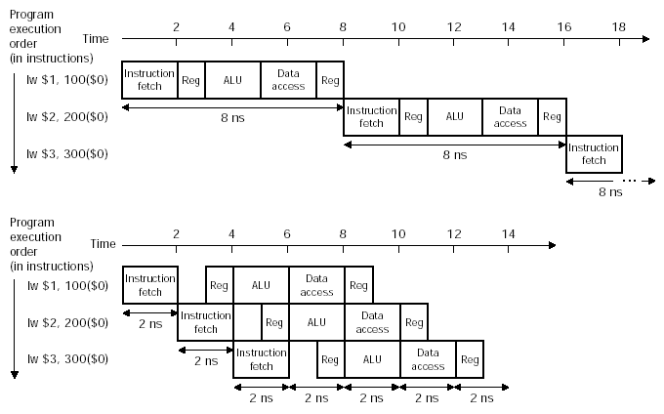
Pipelined execution

Slide 10
Time of pipelined instructions
Time between instructions _{(pipelined)} =
Time between instructions _{(nonpipelined)} / Number of pipeline stages
Under ideal conditions five-stage pipeline is five times faster
Pipeline involves overhead
Time/Instruction exceeds Minimum
Speedup less than number of pipeline stages
Pipeline improves performance by increasing instruction throughput

Slide 11
Designing Instruction Sets for Pipelining
All MIPS instructions are same length
All instructions can be fetched in 1st stage
All instructions can be decoded in 2nd stage
MIPS instructions have few formats
Register fields symmetrical, allowing reading register file along with instruction decoding
If register fields were not symmetrical then two stages are required, decode and register read

Slide 12
Designing Instruction Sets for Pipelining
Memory operands only appear in loads/stores, allowing the execute stage to calculate memory address and access memory in the following stage
In 80x86, operations on memory require additional stages
Data values are aligned in memory, requiring a single memory to access data
80x86 has variable length data values requiring multiple memory accesses

Slide 13
Basic Idea
Single-Cycle Datapath; Colored lines show flow of data backwards.
What do we need to add to split the datapath into stages?

Slide 14
Pipelined (Single-Cycle) Datapath
Pipeline registers (colored), separate the datapath stages.
Must be wide enough to store data, control and conditions as they flow downstream.

Slide 15

Why Pipeline? One Instruction Completes Each Cycle!
Time (clock cycles)
I
n
s
t
r.
O
r
d
e
r
Inst 0
Im
Reg
ALU
Dm
Reg
Inst 1
Im
Reg
ALU
Dm
Reg
Inst 2
Im
Reg
ALU
Dm
Reg
Inst 3
Im
Reg
ALU
Dm
Reg
Inst 4
Im
Reg
ALU
Dm
Reg

Slide 16
Things to Remember
Optimal Pipeline
Each stage is executing part of an instruction each clock cycle.
One instruction finishes during each clock cycle.
On average, execute far more quickly.
What makes this work?
Similarities between instructions allow us to use same stages for all instructions (generally).
Each stage takes about the same amount of time as all others: little wasted time.

Slide 17
Reservation Table
For the following commands calculate the time taken to finish the complete program in both single cycle (non pipelined) execution and single cycle (pipelined) execution.
Use Reservation Table for both executions
Sub $16,$17,$8 → A
And $9,$8,$10 → B
Or $8,$9,$10 → C
Add $8,$9,$10 → D
SW $8,12($s0) → E

Slide 18
Example: Single-Cycle Machines
Let's assume that the operation time for the following units is:
.
Memory | ALU | Reg File | MUX, Control, Sign-Extend, PC accesses and wires
2ns | 2ns | 1ns | 0ns
Format | Fetch | Reg Read | ALU Op | Memory | Reg Write | Total
R- Type | 2ns | 1ns | 2ns | 0 | 1ns | 6ns
Load | 2ns | 1ns | 2ns | 2ns | 1ns | 8ns
Store | 2ns | 1ns | 2ns | 2ns |  | 7ns
Branch | 2ns | 1ns | 2ns |  |  | 5ns
Jump | 2ns |  |  |  |  | 2ns

Slide 19
Reservation Table
Instruction | Clock Cycle Number
 | 1 | 2 | 3 | 4 | 5 | 6 | 7 | 8 | 9 | 10 | 11 | 12 | 13 | 14 | 15 | 16 | 17 | 18 | 19 | 20 | 21 | 22
A
B
C
D
E

Slide 20
Hazards
There are situations in pipelining when the next instruction cannot execute in the following clock cycle. These events are called hazards

Slide 21
Problems for Pipelining CPUs
Limits to pipelining: Hazards prevent next instruction from executing during its designated clock cycle
Structural hazards: HW cannot support some combination of instructions (single person to fold and put clothes away)
Control hazards: Pipelining of branches causes later instruction fetches to wait for the result of the branch
Data hazards: Instruction depends on result of prior instruction still in the pipeline (missing sock)
These might result in pipeline stalls or “bubbles” in the pipeline.

Slide 22
Structural Hazard #1: Single Memory (1/2)
Time (clock cycles)
I
n
s
t
r.
O
r
d
e
r
Load
I$
Reg
ALU
D$
Reg
Instr 1
I$
Reg
ALU
D$
Reg
Instr 2
I$
Reg
ALU
D$
Reg
Instr 3
I$
Reg
ALU
D$
Reg
Instr 4
I$
Reg
ALU
D$
Reg
Read same memory twice in same clock cycle

Slide 23
Structural Hazard #1: Single Memory (2/2)
Solution:
Infeasible and inefficient to create second memory
so simulate this by having two Level 1 Caches (a temporary smaller [of usually most recently used] copy of memory)
Have both an L1 Instruction Cache and an L1 Data Cache
Need more complex hardware to control when both caches miss

Slide 24
Structural Hazard #2: Registers (1/2)
I
n
s
t
r.
O
r
d
e
r
Time (clock cycles)
sw
I$
Reg
ALU
D$
Reg
Instr 1
I$
Reg
ALU
D$
Reg
Instr 2
I$
Reg
ALU
D$
Reg
Instr 3
I$
Reg
ALU
D$
Reg
Instr 4
I$
Reg
ALU
D$
Reg
Can we read and write to registers simultaneously?

Slide 25
Structural Hazard #2: Registers (2/2)
Two different solutions have been used:
1) RegFile access is VERY fast: takes less than half the time of ALU stage
Write to Registers during first half of each clock cycle
Read from Registers during second half of each clock cycle
2) Build RegFile with independent read and write ports
Result: can perform Read and Write during same clock cycle

Slide 26
Eliminating Structural Hazards
Duplicate resource
Pipeline the resource
Reorder the instructions
Stall → if its is too expensive to eliminate a structural hazard
No new instruction is issued until the hazard has been resolved

Slide 27
Data Hazards
Dependencies are property of the programs
Whether a dependence lead to an actual Hazards and whether the hazard actually cause a stall are properties of the pipeline organization
There are three main types of the dependencies in the program:
Data dependencies
Name dependencies
Control dependencies

Slide 28
Data Dependencies
An instruction x is data dependent on instruction y, iff either of
Direct: Instruction x produces a result that is used by instruction y
R3 ← R1 Operation R2
R5 ← R3 Operation R4
Transitive: Instruction y is data dependent on instruction z and Instruction z is data dependent on instruction x
R3 ← R1 Operation R2
R4 ← R3 Operation R2
R5 ← R6 Operation R4
Dependence within a single instruction (such as ADD R1,R1,R1) is not considered as a dependence

Slide 29
Data Dependencies
If two instructions are data dependent, they cannot be executed simultaneously or be completely overlapped
Example:
Loop: LW $8, 12($15)
ADD $9,$8,$0
SW $9,12($15)
ADDI $15,$15,-1
BNE $15,$16,Loop
A data dependence leads to three things
The possibility of a hazard
The order in which the result needs to be calculated
An upper bound on how much parallelism can be explited

Slide 30
Data Dependencies
A data dependence can limit the instruction level parallelism
A dependence can be overcome in two different ways
Maintaining the dependence by avoiding a hazard
Eliminating a dependence by transforming the code

Slide 31
Detecting Data Dependencies
A data value may flow between instructions
Through registers
Through memory locations
When data flow is through registers:
Detection is rather straight forward
When data flow is through memory:
Two address may refer to the same location but looks different
20($s0) and 10($s1)
The effective address may differ from one execution to another 20($s0) in one instruction may differ from 20($s0) in another

Slide 32
Name Dependencies
Name Dependence
Two instructions use the same register or memory location (called a name)
There is no true data flow between two instructions
Example: A= B+C ; A=P+Q
Two type of name dependence
Anti-dependence
Output dependence

Slide 33
Structural Hazards
Determines the ordering of an instruction with respect to a branch instruction. Example
If P1 {
S1;
}
If P2 {
S2;
}
S1 is control dependent on p1, but S2 is not control dependent on p1
An instruction that is control dependent on a branch cannot be moved before the branch
An instruction that is not control dependent on a branch cannot be moved after the branch

Slide 34
Structural Hazards
When program order is strictly preserved, it ensures that control dependences are also preserved
Example
SUB $t0,$t1,$t2
BEQ $t0,$ZERO,L1
LW $S0,0($t0)
L1:

Slide 35
Example Data Hazards
SUB $2, $1, $3
AND $12, $2, $5
OR $13, $6, $2
ADD $14, $2, $2
SW $15, 100($2)

Slide 36
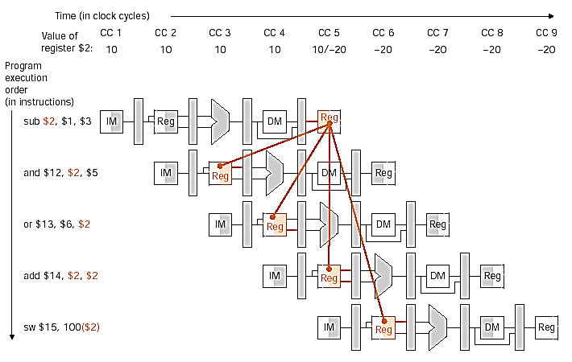
Data Hazards & forwarding

Slide 37
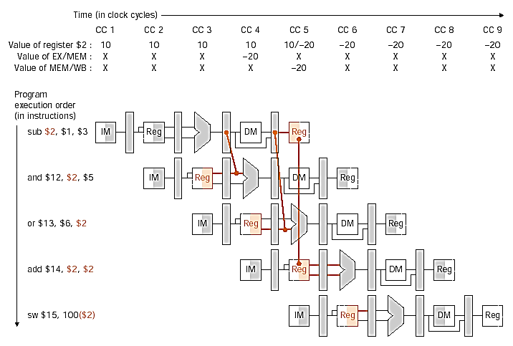
Forwarding Data

Slide 38
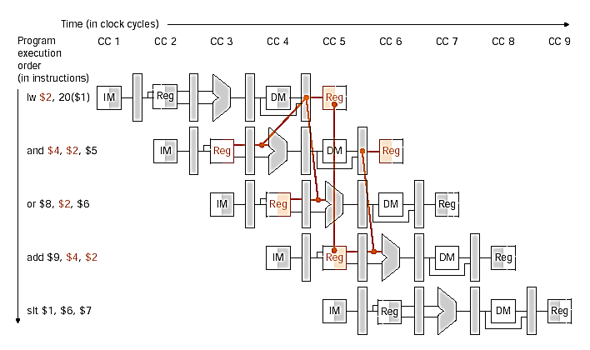
Data Hazards and Stalls

Slide 39
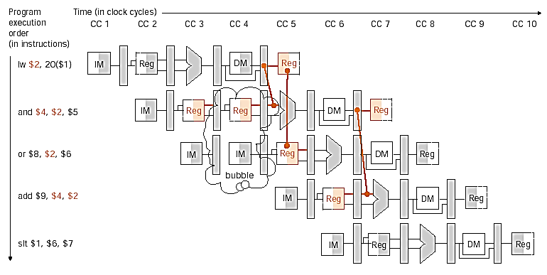
Data Hazard and Stall

